Slide 1

BUSINESS STRATEGIES PROJECT
Gogiltan Alexia
Goldut Eduard
Gologan Nicoleta
Neacsu Dragos

Slide 2




The team
Goldut Eduard
Chief Executive Officer
Payroll
Establishing objectives and the strategic direction of the company
Accounting firm relation
Investor relation
Gologan Nicoleta
Office Manager
Management of client appointments
Supplier relationship and logistics management
Gogiltan Alexia
Chief Marketing Officer
Managing the marketing and communications of the company
Updating the webpage and managing the social media account
Email Marketing, social media marketing, analytics
Neacsu Dragos
Chief Operation Officer
Supervising the execution of services (grooming and vet)
Organising the schedule of vets
Managing costs and payments

Slide 3
01
Adressable Market

Slide 4
Market size *(m EUR)
 |  | 2017 | 2018 | 2019 | 2020 | 2021 | 2022 | 2023 | 2024 | 2025 | 2026
 | EUR | 1,000,000 | 1,250,000 | 1,562,500 | 1,640,625 | 1,886,719 | 2,169,727 | 2,495,186 | 2,869,463 | 3,299,883 | 3,794,865
 | YoY Growth (%) | 25% | 25% | 25% | 5% | 15%
Market size estimation (by confidence level)
Pesimistic |  | 2020 | 2021 | 2022 | 2023 | 2024 | 2025 | 2026
 |  | € 1,640,625.00 | € 1,722,656.25 | € 1,808,789.06 | € 1,899,228.52 | € 1,994,189.94 | € 2,093,899.44 | € 2,198,594.41
 |  | 5%
Optimistic |  | 2020 | 2021 | 2022 | 2023 | 2024 | 2025 | 2026
 |  | € 1,796,875.00 | € 2,066,406.25 | € 2,376,367.19 | € 2,732,822.27 | € 3,142,745.61 | € 3,614,157.45 | € 4,156,281.06
 |  | 15%
 |  | Avg client expenditure/ year | Our market | Profit pool | Market share
Total | 8,500,000 | € 40.00 | € 340,000,000.00 | € 85,000,000.00 | € 4,250,000.00
Romania pop. | 19,000,000
% of dog and cat owners | 45%

Slide 5
02
Competitive landscape

Slide 6
S&Ws
STRENGTHS
WEAKNESSES
High demand for grooming services
Reduced operational costs (services)
Professional staff (trained)
supplies for breeds of all sizes need to be purchased and maintained (costly investments)
Hard to find employees that have a proper experience and suitable skills to handle multiple pets, breeds, animal temperaments, and grooming skill
Reduced differentiation possibilities

Slide 7


Direct
competition
Indirect
competition
Royal Pet Spa
Fitz Pet Salon
Perfect Pet Salon
Alpha Pet
Blue Pet Salon
Lofty Pets
Groom Vet
Labute Fericite
- - - - - -
Sanita vet
Geo’s Medical Vet
Pet Stuff
A&A Medical Vet
Lamy Vet
- - - - - -

Slide 8
Jan-21 | Feb-21 | Mar-21 | Apr-21 | May-21 | Jun-21 | Jul-21 | Aug-21 | Sep-21 | Oct-21 | Nov-21 | Dec-21 | FY21 | FY22 | FY23
Webpage and host (Wix Pro Plan) | 20 | 20 | 20 | 20 | 20 | 20 | 20 | 20 | 20 | 20 | 20 | 20 | 240 | 240 | 240
Logo | 100
Instagram and Facebook Ads | 400 | 400 | 400 | 400 | 400 | 400 | 400 | 400 | 400 | 400 | 400 | 400 | 4,800 | 4,800 | 4,800
Email and Message Marketing | 40 | 40 | 40 | 40 | 40 | 40 | 40 | 40 | 40 | 40 | 40 | 40 | 480 | 480 | 480
TOTAL MARKETING & IT COSTS | 560 | 460 | 460 | 460 | 460 | 460 | 460 | 460 | 460 | 460 | 460 | 460 | 5,520 | 5,520 | 5,520
Porter’s five forces analysis
The threat of new entrants for this industry is moderate. The new players can obtain the pets' grooming technologies and materials easily but it is not easy for them to become a popular brand.
Threat of substitute is high because most vets also have grooming services. (Therefore, we need to differentiate)
The bargaining power of buyers is low because we have fixed prices but they can choose to buy only the basic services/products.
The bargaining power of suppliers is moderate,
The rivalry among existing competitors is high.

Slide 9
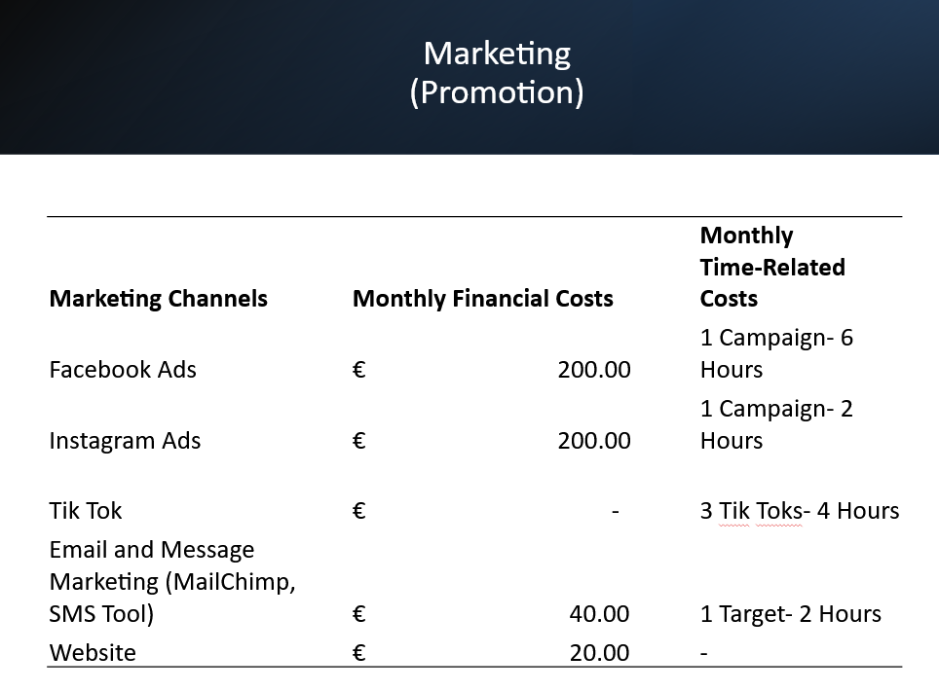

Slide 10
03
Customer profile
Socio-demographics & lifestyle:
+25 years old, Bucharest area, cat/dog owner, minimum wage of 11,000 eur/year, looking for high quality services, active lifestyle
Unsolved needs:
They want qualitative services, flexible hours when they can bring their pet to the grooming appointment, monthly delivered pet consumables to save time.

Slide 11
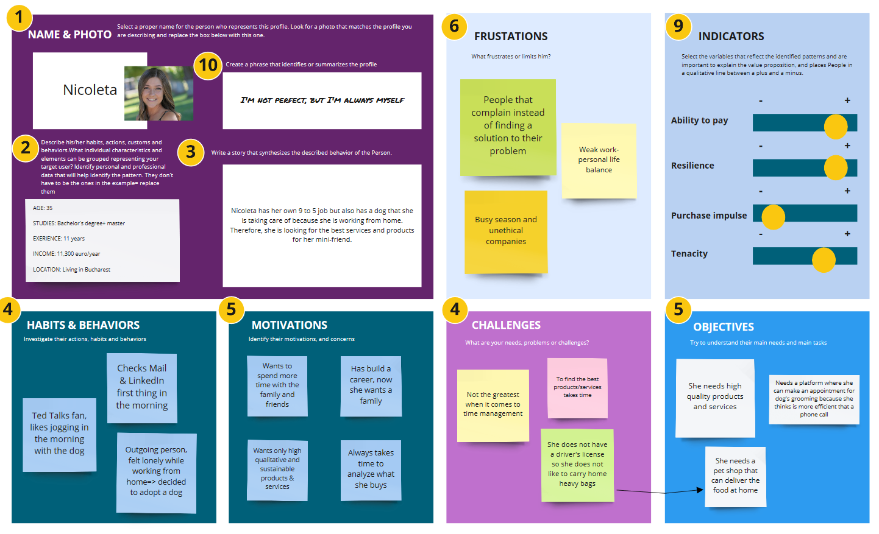

Slide 12
04
Business Model

Slide 13
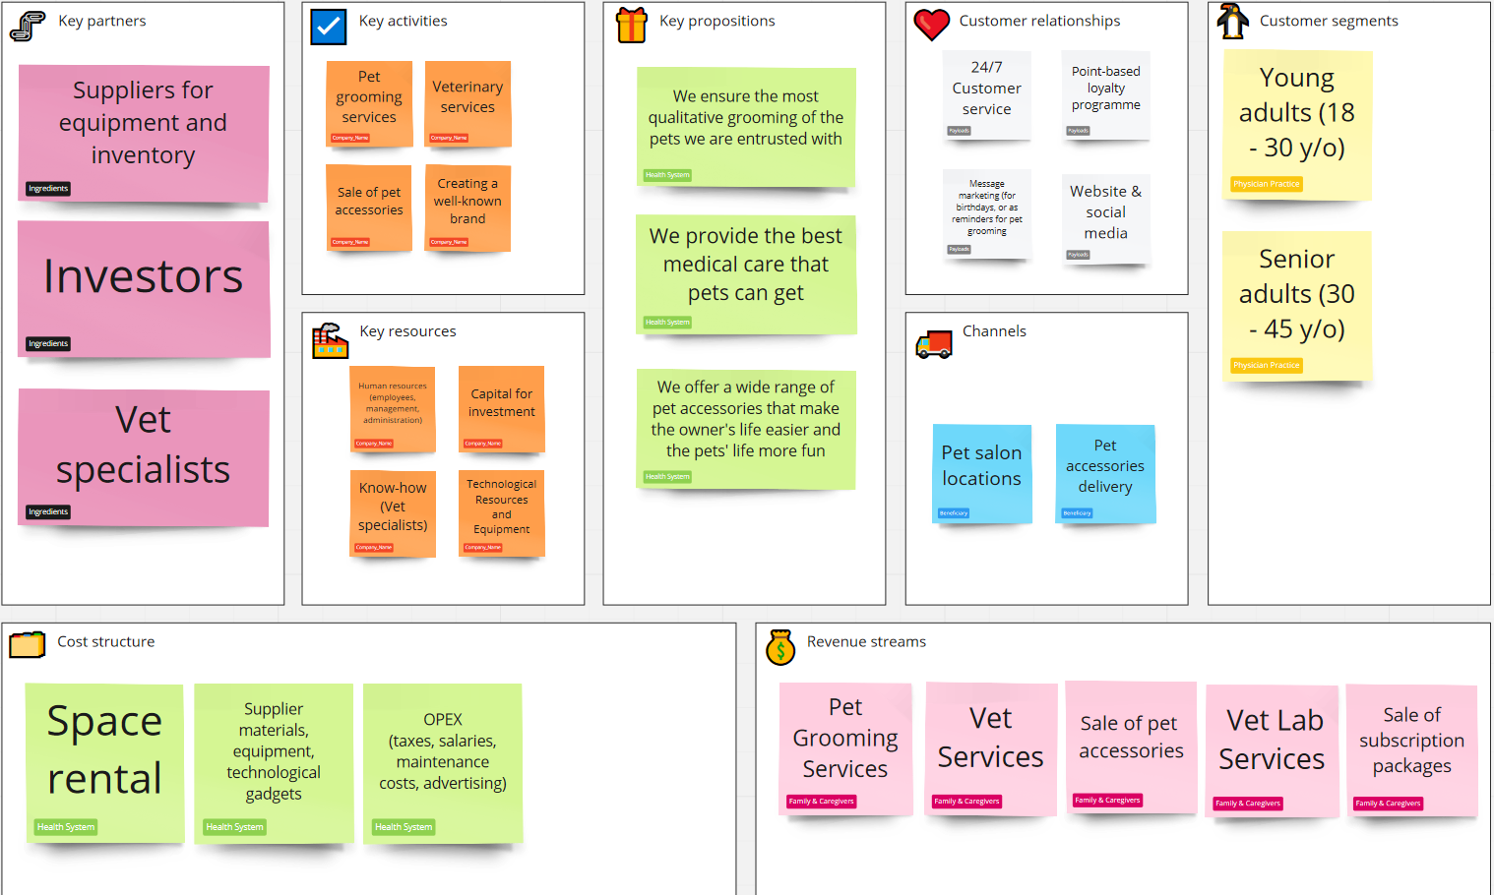

Slide 14
05
Competitive Advantage

Slide 15
S&Ws
STRENGTHS
WEAKNESSES
Coverage of a variety of services
Access to monthly pet packages
Strong customer support
Active marketing campaigns
Professional & trained staff
Difficult to scale at start due to market saturation
High initial investment
Difficult to do customer hunting (except ads)

Slide 16
Competitive advantages
Quality - The pet shop that we will be running will have a rigorous standard of quality and client feedback will always be required in order to constantly acknowledge we are doing the best job. We will be using modern technologies and quality equipment in all of our activity.
Skills - Employees are rigorously tested before being hired and then the firm invests in their training and expertise in order to assure that we have a skilled team that performs the job very well.
Patents - N/A
Access to resources - angel investors, own funding, crowdfunding
Brand - The marketing activity will be constant and persistent in order to create a trustworthy brand that is well known for quality and promptness in all of its services, a brand that people can easily go to when they need vet and pet grooming services.
Innovation - Monthly packages of toys and food for pets.

Slide 17
06
Bussines traction

Slide 18
P&L Super Vet (EUR) | Jan-21 | Feb-21 | Mar-21 | Apr-21 | May-21 | Jun-21 | Jul-21 | Aug-21 | Sep-21 | Oct-21 | Nov-21 | Dec-21 | FY21 | FY22 | FY23
Number of Loans | 0 | 0 | 0 | 0 | 0 | 0 | 0 | 0 | 0 | 0 | 0 | 0 | 0 | 0 | 0
TOTAL LOANS VALUE |  |  |  |  |  |  |  |  |  |  |  |  | 0
Digital Bank INCOME |  |  |  |  |  |  |  |  |  |  |  |  | 0
Payroll HQ | 4,750 | 4,750 | 4,750 | 4,750 | 4,750 | 4,750 | 4,750 | 4,750 | 4,750 | 4,750 | 4,750 | 4,750 | 61,800 | 68,400 | 68,400
Payroll taxes | 2,138 | 2,138 | 2,138 | 2,138 | 2,138 | 2,138 | 2,138 | 2,138 | 2,138 | 2,138 | 2,138 | 2,138 | 25,650 | 41,873 | 66,623
TOTAL PERSONNEL COSTS | 6,888 | 6,888 | 6,888 | 6,888 | 6,888 | 6,888 | 6,888 | 6,888 | 6,888 | 6,888 | 6,888 | 6,888 | 82,650 | 110,273 | 135,023
Professional indemnity insurance | 35 | 35 | 35 | 35 | 35 | 35 | 35 | 35 | 35 | 35 | 35 | 35 | 420
Firm Creation and Registering | 200 | 0 | 0 | 0 | 0 | 0 | 0 | 0 |  |  |  |  | 0 | 0 | 0
Accounting Services (100-150 accounting registers) | 100 | 100 | 100 | 100 | 100 | 100 | 100 | 100 | 100 | 100 | 100 | 100 | 1,200 | 1,300 | 1,300
LEGAL & COMPLIANCY | 335 | 9,135 | 9,135 | 9,135 | 9,135 | 135 | 135 | 135 |  |  |  |  | 37,280 | 1,300 | 1,300
Webpage and host (Wix Pro Plan) | 20 | 20 | 20 | 20 | 20 | 20 | 20 | 20 | 20 | 20 | 20 | 20 | 240 | 240 | 240
Logo | 100 |  |  |  |  |  |  |  |  |  |  |  | 100 | 0 | 0
Instagram and Facebook Ads | 400 | 400 | 400 | 400 | 400 | 400 | 400 | 400 | 400 | 400 | 400 | 400 | 4800 | 4800 | 4800
Email and Message Marketing | 40 | 40 | 40 | 40 | 40 | 40 | 40 | 40 | 40 | 40 | 40 | 40 | 480 | 480 | 480
TOTAL MARKETING & IT COSTS | 120 | 460 | 460 | 460 | 460 | 460 | 460 | 460 | 460 | 460 | 460 | 460 | 5620 | 5520 | 5520
Telephone & Internet | 10 | 10 | 10 | 10 | 10 | 10 | 10 | 10 | 10 | 10 | 10 | 10 | 120 | 120 | 120
Rent HQ | 1,500 | 1,500 | 1,500 | 1,500 | 1,500 | 1,500 | 1,500 | 1,500 | 1,500 | 1,500 | 1,500 | 1,500 | 18,000 | 12,000 | 12,000
Real estate expenses (utilities) | 250 | 250 | 250 | 250 | 250 | 250 | 250 | 250 | 250 | 250 | 250 | 250 | 3,000 | 2,000 | 2,000
Consumables (medicines, dezinfection liquids, syringes, small plastic containers, tissues, shampoo, cleaning consumables, bandanas, sprays, conditioners, animal food) | 1,500 | 1,500 | 1,500 | 1,500 | 1,500 | 1,500 | 1,500 | 1,500 | 1,500 | 1,500 | 1,500 | 1,500 | 18,000 | 18,000 | 18,000
Grooming Accessories (scissors, brushes, clippers, nail clippers) | 270 | 0 | 0 | 0 | 0 | 0 | 0 | 0 | 0 | 0 | 0 | 0 | 270 | 0 | 0
Groomin Equipment (bathtubs, washing machines, dryers, cages, and professional grooming tables) | 800 | 0 | 0 | 0 | 0 | 0 | 0 | 0 | 0 | 0 | 0 | 0 | 800 | 0 | 0
Vet Accessories (surgery equipment, medical robe) | 700 | 0 | 0 | 0 | 0 | 0 | 0 | 0 | 0 | 0 | 0 | 0 | 700 | 0 | 0
Vet Equipment (Ultrasounds, portable ultrasounds, surgery tables, X-RAY) | 37,600 | 0 | 0 | 0 | 0 | 0 | 0 | 0 | 0 | 0 | 0 | 0 | 37,600 | 0 | 0
Other costs |  |  |  |  |  |  |  |  |  |  |  |  | 0 | 0 | 0
TOTAL OTHER OPERATING EXP. | 42,630 | 3,260 | 3,260 | 3,260 | 3,260 | 3,260 | 3,260 | 3,260 | 3,260 | 3,260 | 3,260 | 3,260 | 78,490 | 32,120 | 32,120
TOTAL OPERATING EXPENSES | 49,973 | 19,303 | 19,303 | 19,303 | 19,303 | 10,303 | 10,303 | 10,303 | 10,148 | 10,148 | 10,148 | 10,148 | 198,680 | 143,933 | 168,683
RESULT | -€ 49,973 | -€ 19,303 | -€ 19,303 | -€ 19,303 | -€ 19,303 | -€ 10,303 | -€ 10,303 | -€ 10,303 |  |  |  |  | -€ 158,090 | -€ 143,933 | -€ 168,683

Slide 19
Price (Euro) | Jan-21 | Feb-21 | Mar-21 | Apr-21 | May-21 | Jun-21 | Jul-21 | Aug-21 | Sep-21 | Oct-21 | Nov-21 | Dec-21 | FY 2021
Revenue Stream 1- Grooming Services | €652.00 | €652.00 | €680.00 | €680.00 | €708.00 | €1,008.00 | €1,020.00 | €1,020.00 | €992.00 | €532.00 | €532.00 | €532.00 | €9,008.00
Haircut+washing | €600.00 | €600.00 | €600.00 | €600.00 | €600.00 | €900.00 | €900.00 | €900.00 | €900.00 | €480.00 | €480.00 | €480.00 | €8,040.00
Nailcut+cleaning ears | €36.00 | €36.00 | €48.00 | €48.00 | €60.00 | €60.00 | €72.00 | €72.00 | €60.00 | €36.00 | €36.00 | €36.00 | €600.00
Parfume+fresh breathing | €16.00 | €16.00 | €32.00 | €32.00 | €48.00 | €48.00 | €48.00 | €48.00 | €32.00 | €16.00 | €16.00 | €16.00 | €368.00
Revenue Stream 2- Vet Services (chirurgical operations, consultation) | €3,000.00 | €3,000.00 | €3,000.00 | €3,000.00 | €3,000.00 | €5,800.00 | €5,800.00 | €5,800.00 | €3,000.00 | €3,000.00 | €3,000.00 | €3,000.00 | €44,400.00
Chirurgical Operations | €2,800.00 | €2,800.00 | €2,800.00 | €2,800.00 | €2,800.00 | €5,600.00 | €5,600.00 | €5,600.00 | €2,800.00 | €2,800.00 | €2,800.00 | €2,800.00 | €42,000.00
Consultation | €200.00 | €200.00 | €200.00 | €200.00 | €200.00 | €200.00 | €200.00 | €200.00 | €200.00 | €200.00 | €200.00 | €200.00 | €2,400.00
Revenue Stream 3- Vet Lab Services (MRI, ultrasounds, quick tests) | €380.00 | €380.00 | €380.00 | €380.00 | €380.00 | €480.00 | €480.00 | €480.00 | €480.00 | €860.00 | €860.00 | €860.00 | €6,400.00
Veterinary Imaging | €280.00 | €280.00 | €280.00 | €280.00 | €280.00 | €280.00 | €280.00 | €280.00 | €280.00 | €560.00 | €560.00 | €560.00 | €4,200.00
Rapid Tests (blood tests) | €100.00 | €100.00 | €100.00 | €100.00 | €100.00 | €200.00 | €200.00 | €200.00 | €200.00 | €300.00 | €300.00 | €300.00 | €2,200.00
Revenue Stream 4- Sales of Pet Accessories | €37.00 | €37.00 | €37.00 | €37.00 | €37.00 | €37.00 | €37.00 | €37.00 | €37.00 | €37.00 | €37.00 | €37.00 | €444.00
Pet accesories | €37.00 | €37.00 | €37.00 | €37.00 | €37.00 | €37.00 | €37.00 | €37.00 | €37.00 | €37.00 | €37.00 | €37.00 | €444.00
Revenue Stream 5-Subscription package | €75.00 | €75.00 | €75.00 | €75.00 | €100.00 | €100.00 | €100.00 | €100.00 | €100.00 | €125.00 | €125.00 | €125.00 | €1,175.00
Revenues from sales of food, shampoo, and one toy | € 75 | € 75 | € 75 | € 75 | € 100 | € 100 | € 100 | € 100 | € 100 | € 125 | € 125 | € 125 | €1,175.00
€61,427.00

Slide 20
Price (Euro) | Jan-22 | Feb-22 | Mar-22 | Apr-22 | May-22 | Jun-22 | Jul-22 | Aug-22 | Sep-22 | Oct-22 | Nov-22 | Dec-22 | FY 2022
Revenue Stream 1- Grooming Services | €1,660.00 | €1,660.00 | €1,660.00 | €1,660.00 | €1,660.00 | €1,660.00 | €1,660.00 | €1,660.00 | €1,660.00 | €1,660.00 | €1,660.00 | €1,660.00 | €19,920.00
Haircut+washing | €1,500.00 | €1,500.00 | €1,500.00 | €1,500.00 | €1,500.00 | €1,500.00 | €1,500.00 | €1,500.00 | €1,500.00 | €1,500.00 | €1,500.00 | €1,500.00 | €18,000.00
Nailcut+cleaning ears | €120.00 | €120.00 | €120.00 | €120.00 | €120.00 | €120.00 | €120.00 | €120.00 | €120.00 | €120.00 | €120.00 | €120.00 | €1,440.00
Parfume+fresh breathing | €40.00 | €40.00 | €40.00 | €40.00 | €40.00 | €40.00 | €40.00 | €40.00 | €40.00 | €40.00 | €40.00 | €40.00 | €480.00
Revenue Stream 2- Vet Services (chirurgical operations, consultation) | €3,850.00 | €3,850.00 | €3,850.00 | €3,850.00 | €3,850.00 | €3,850.00 | €3,850.00 | €3,850.00 | €3,850.00 | €3,850.00 | €3,850.00 | €3,850.00 | €46,200.00
Chirurgical Operations | €3,500.00 | €3,500.00 | €3,500.00 | €3,500.00 | €3,500.00 | €3,500.00 | €3,500.00 | €3,500.00 | €3,500.00 | €3,500.00 | €3,500.00 | €3,500.00 | €42,000.00
Consultation | €350.00 | €350.00 | €350.00 | €350.00 | €350.00 | €350.00 | €350.00 | €350.00 | €350.00 | €350.00 | €350.00 | €350.00 | €4,200.00
Revenue Stream 3- Vet Lab Services (RMN, ultrasounds, quick tests) | €520.00 | €520.00 | €520.00 | €520.00 | €520.00 | €620.00 | €620.00 | €620.00 | €620.00 | €860.00 | €860.00 | €860.00 | €7,660.00
Veterinary Imaging | €420.00 | €420.00 | €420.00 | €420.00 | €420.00 | €420.00 | €420.00 | €420.00 | €420.00 | €560.00 | €560.00 | €560.00 | €5,460.00
Rapid Tests (blood tests) | €100.00 | €100.00 | €100.00 | €100.00 | €100.00 | €200.00 | €200.00 | €200.00 | €200.00 | €300.00 | €300.00 | €300.00 | €2,200.00
Revenue Stream 4- Sales of Pet Accessories | €65.10 | €65.10 | €65.10 | €65.10 | €65.10 | €65.10 | €65.10 | €65.10 | €65.10 | €65.10 | €65.10 | €65.10 | €781.20
Pet accesories | €65.10 | €65.10 | €65.10 | €65.10 | €65.10 | €65.10 | €65.10 | €65.10 | €65.10 | €65.10 | €65.10 | €65.10 | €781.20
Revenue Stream 5-Subscription package | €75.00 | €75.00 | €75.00 | €75.00 | €100.00 | €100.00 | €100.00 | €100.00 | €100.00 | €125.00 | €125.00 | €125.00 | €1,175.00
Revenues from sales of food, shampoo, and one toy | € 75 | € 75 | € 75 | € 75 | € 100 | € 100 | € 100 | € 100 | € 100 | € 125 | € 125 | € 125 | €1,175.00
€75,736.20

Slide 21
Price (Euro) | Jan-23 | Feb-23 | Mar-23 | Apr-23 | May-23 | Jun-23 | Jul-23 | Aug-23 | Sep-23 | Oct-23 | Nov-23 | Dec-23 | FY2023
Revenue Stream 1- Grooming Services | €3,280.00 | €3,280.00 | €3,280.00 | €3,280.00 | €3,280.00 | €3,280.00 | €3,280.00 | €3,280.00 | €3,280.00 | €3,280.00 | €3,280.00 | €3,280.00 | €39,360.00
Haircut+washing | €3,000.00 | €3,000.00 | €3,000.00 | €3,000.00 | €3,000.00 | €3,000.00 | €3,000.00 | €3,000.00 | €3,000.00 | €3,000.00 | €3,000.00 | €3,000.00 | €36,000.00
Nailcut+cleaning ears | €240.00 | €240.00 | €240.00 | €240.00 | €240.00 | €240.00 | €240.00 | €240.00 | €240.00 | €240.00 | €240.00 | €240.00 | €2,880.00
Parfume+fresh breathing | €40.00 | €40.00 | €40.00 | €40.00 | €40.00 | €40.00 | €40.00 | €40.00 | €40.00 | €40.00 | €40.00 | €40.00 | €480.00
Revenue Stream 2- Vet Services (chirurgical operations, consultation) | €5,500.00 | €5,500.00 | €5,500.00 | €5,500.00 | €5,500.00 | €5,500.00 | €5,500.00 | €5,500.00 | €5,500.00 | €5,500.00 | €5,500.00 | €5,500.00 | €66,000.00
Chirurgical Operations | €4,900.00 | €4,900.00 | €4,900.00 | €4,900.00 | €4,900.00 | €4,900.00 | €4,900.00 | €4,900.00 | €4,900.00 | €4,900.00 | €4,900.00 | €4,900.00 | €58,800.00
Consultation | €600.00 | €600.00 | €600.00 | €600.00 | €600.00 | €600.00 | €600.00 | €600.00 | €600.00 | €600.00 | €600.00 | €600.00 | €7,200.00
Revenue Stream 3- Vet Lab Services (RMN, ultrasounds, quick tests) | €940.00 | €940.00 | €940.00 | €940.00 | €940.00 | €1,040.00 | €1,040.00 | €1,040.00 | €1,040.00 | €1,140.00 | €1,140.00 | €1,140.00 | €12,280.00
Veterinary Imaging | €840.00 | €840.00 | €840.00 | €840.00 | €840.00 | €840.00 | €840.00 | €840.00 | €840.00 | €840.00 | €840.00 | €840.00 | €10,080.00
Rapid Tests (blood tests) | €100.00 | €100.00 | €100.00 | €100.00 | €100.00 | €200.00 | €200.00 | €200.00 | €200.00 | €300.00 | €300.00 | €300.00 | €2,200.00
Revenue Stream 4- Sales of Pet Accessories | €139.50 | €139.50 | €139.50 | €139.50 | €139.50 | €139.50 | €139.50 | €139.50 | €139.50 | €139.50 | €139.50 | €139.50 | €1,674.00
Pet accesories | €139.50 | €139.50 | €139.50 | €139.50 | €139.50 | €139.50 | €139.50 | €139.50 | €139.50 | €139.50 | €139.50 | €139.50 | €1,674.00
Revenue Stream 5-Subscription package | €75.00 | €75.00 | €75.00 | €75.00 | €100.00 | €100.00 | €100.00 | €100.00 | €100.00 | €125.00 | €125.00 | €125.00 | €1,175.00
Revenues from sales of food, shampoo, and one toy | € 75 | € 75 | € 75 | € 75 | € 100 | € 100 | € 100 | € 100 | € 100 | € 125 | € 125 | € 125 | €1,175.00
€120,489.00

Slide 22
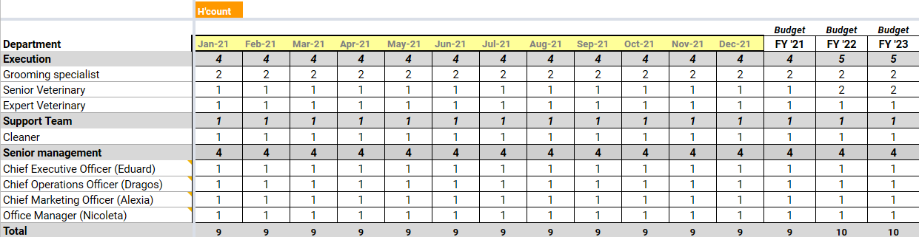
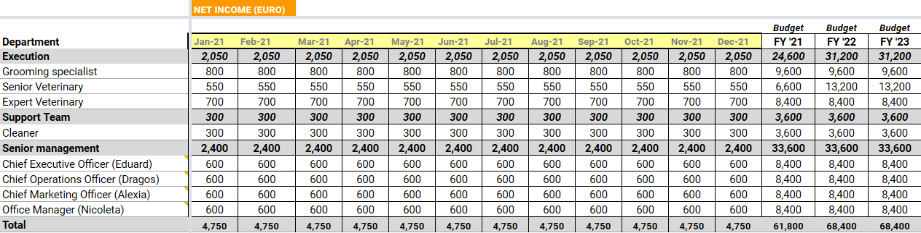

Slide 23
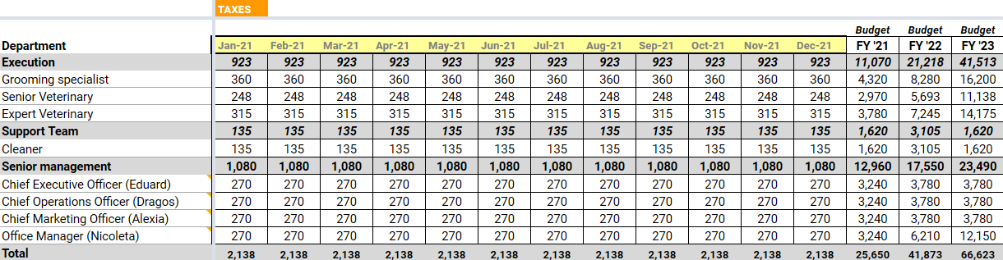

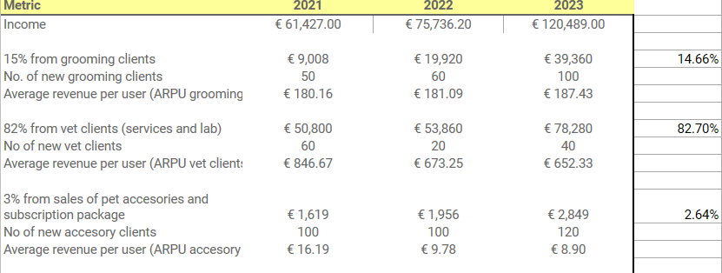

Slide 24
07
Growth strategy & technical development

Slide 25
Growth Strategy
2021
2022
2023
2024
2025
Create a strong brand image
Create operational efficiency
Developing multiple revenue streams
Opening new locations
Reaching BEP and profitability

Slide 26
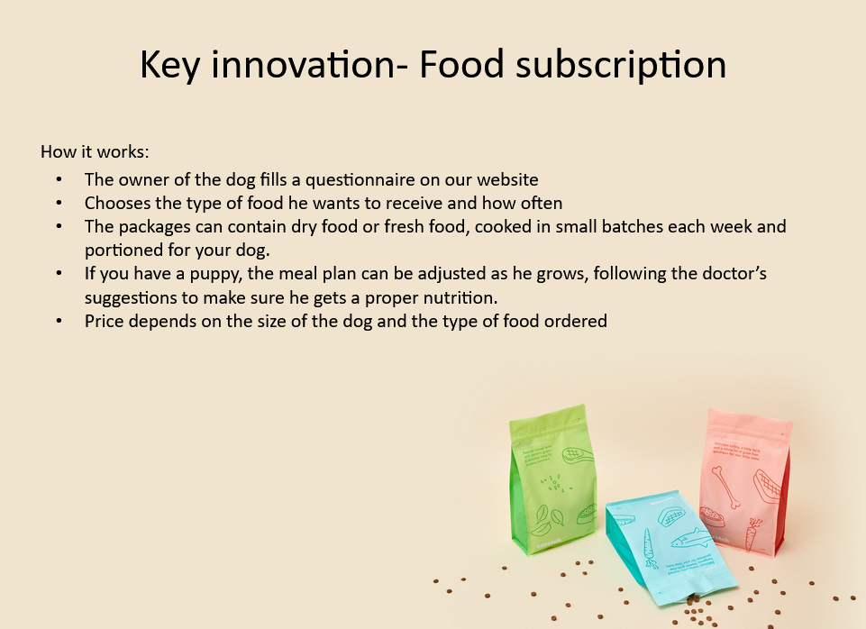

Slide 27
Thanks

